Slide 1
Economics & Business

Slide 2
Begin your notes by writing down the following… you have 2 minutes!
Title: Introduction to Economics and Business
Learning Intention: Understand the basis concepts of Economics and Business.
Success Criteria: Can explain what economics means and list 3 important concepts associated with the topic.
2:00
1:59
1:58
1:57
1:56
1:55
1:54
1:53
1:52
1:51
1:50
1:49
1:48
1:47
1:46
1:45
1:44
1:43
1:42
1:41
1:40
1:39
1:38
1:37
1:36
1:35
1:34
1:33
1:32
1:31
1:30
1:29
1:28
1:27
1:26
1:25
1:24
1:23
1:22
1:21
1:20
1:19
1:18
1:17
1:16
1:15
1:14
1:13
1:12
1:11
1:10
1:09
1:08
1:07
1:06
1:05
1:04
1:03
1:02
1:01
1:00
0:59
0:58
0:57
0:56
0:55
0:54
0:53
0:52
0:51
0:50
0:49
0:48
0:47
0:46
0:45
0:44
0:43
0:42
0:41
0:40
0:39
0:38
0:37
0:36
0:35
0:34
0:33
0:32
0:31
0:30
0:29
0:28
0:27
0:26
0:25
0:24
0:23
0:22
0:21
0:20
0:19
0:18
0:17
0:16
0:15
0:14
0:13
0:12
0:11
0:10
0:09
0:08
0:07
0:06
0:05
0:04
0:03
0:02
0:01
End

Slide 3
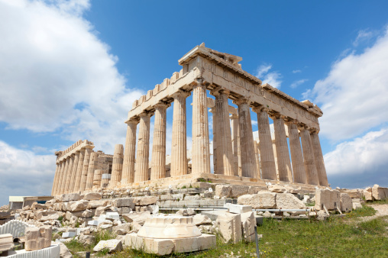
First a little bit of History… the word economy originated from Ancient Greece

Slide 4
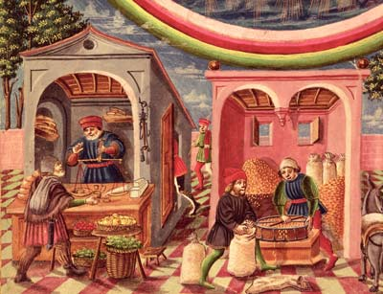
In ancient times…
The economy was mainly based on subsistence farming
In around 3000 BC in a place called Mesopotamia people used barley as a unit of exchange (money)
People would exchange goods through social relationships
There were also traders who bartered in marketplaces.

Slide 5
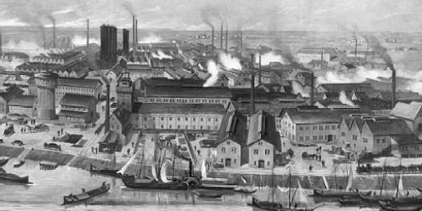
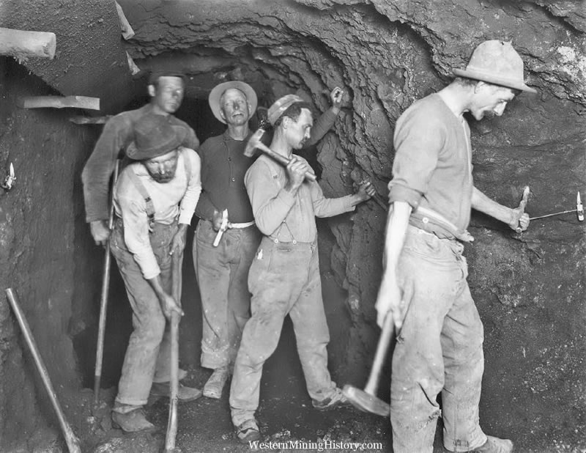
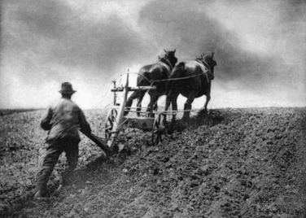
The Industrial Revolution…
When it came time for the industrial revolution farming changed into more extensive forms of agriculture.
Economic Growth took place mosting in mining, construction and manufacturing

Slide 6
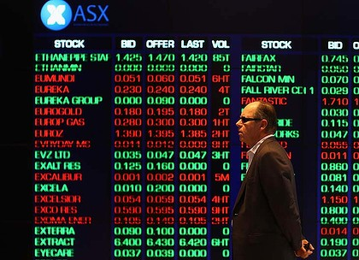
Present day…
We now have modern consumer societies where there is a growing part played by services, finance and ICTs

Slide 7
Economics
So what do you think this means?

Slide 8

Economics is the study of people, choices and resource allocation.

Slide 9
The Economic
Problem.
Complete the worksheet “What Economics is really about in pairs… be prepared to share!
2:00
1:59
1:58
1:57
1:56
1:55
1:54
1:53
1:52
1:51
1:50
1:49
1:48
1:47
1:46
1:45
1:44
1:43
1:42
1:41
1:40
1:39
1:38
1:37
1:36
1:35
1:34
1:33
1:32
1:31
1:30
1:29
1:28
1:27
1:26
1:25
1:24
1:23
1:22
1:21
1:20
1:19
1:18
1:17
1:16
1:15
1:14
1:13
1:12
1:11
1:10
1:09
1:08
1:07
1:06
1:05
1:04
1:03
1:02
1:01
1:00
0:59
0:58
0:57
0:56
0:55
0:54
0:53
0:52
0:51
0:50
0:49
0:48
0:47
0:46
0:45
0:44
0:43
0:42
0:41
0:40
0:39
0:38
0:37
0:36
0:35
0:34
0:33
0:32
0:31
0:30
0:29
0:28
0:27
0:26
0:25
0:24
0:23
0:22
0:21
0:20
0:19
0:18
0:17
0:16
0:15
0:14
0:13
0:12
0:11
0:10
0:09
0:08
0:07
0:06
0:05
0:04
0:03
0:02
0:01
End

Slide 10
Scarcity Video
Watch the following video on introducing economics and scarcity.
Feel free to take notes during the 5 minute video.

Slide 11
In your notes write down this definition of Scarcity…
Scarcity exists when there is not enough of something (product/service/resource) to satisfy everyone’s wants, at a zero price (for free).

Slide 12
Humanities and Social Sciences 7 Textbook
Turn to page 53 of the textbook…
30
29
28
27
26
25
24
23
22
21
20
19
18
17
16
15
14
13
12
11
10
9
8
7
6
5
4
3
2
1
End

Slide 13
Create a glossary and find definitions for the following terms…
Needs
Wants
Producers
Consumers

Slide 14
Reflect on the success criteria…
Success Criteria: Can explain what economics means and list 3 important concepts associated with the topic.

Slide 15
Quiz Time!
Answer the next 10 multiple choice questions
by writing down the letter you think corresponds to
the correct answer.
Be prepared to have your answers marked by a peer.

Slide 16
1. Entrepreneurs are motivated mainly by…
a need to be in charge.
the desire for risk.
the hope of making a profit.
the need to repay their loans.
30
29
28
27
26
25
24
23
22
21
20
19
18
17
16
15
14
13
12
11
10
9
8
7
6
5
4
3
2
1
End

Slide 17
2. When a country brings in a product from another country it is a/an…
export
import
opportunity cost
service
30
29
28
27
26
25
24
23
22
21
20
19
18
17
16
15
14
13
12
11
10
9
8
7
6
5
4
3
2
1
End

Slide 18
3. A is a person who uses goods.
producer
consumer
economists
none of the above
30
29
28
27
26
25
24
23
22
21
20
19
18
17
16
15
14
13
12
11
10
9
8
7
6
5
4
3
2
1
End

Slide 19
4. Which is a type of resource?
Land
Labour
Capital
Enterprise
All of the Above
30
29
28
27
26
25
24
23
22
21
20
19
18
17
16
15
14
13
12
11
10
9
8
7
6
5
4
3
2
1
End

Slide 20
5. A cost or obligation that occurs infrequently and varies in amount spent from month to month (entertainment, clothing, gas for your car).
Fixed Expense
Surcharge
Variable Expense
Tax
30
29
28
27
26
25
24
23
22
21
20
19
18
17
16
15
14
13
12
11
10
9
8
7
6
5
4
3
2
1
End

Slide 21
6. The resources of an economic system, called Factors of Production are grouped into four categories which are…
traditional, command, market, and mixed.
land, capital, labour, and entrepreneurs.
monopoly, oligopoly, private, and government.
local, central, national, and global.
30
29
28
27
26
25
24
23
22
21
20
19
18
17
16
15
14
13
12
11
10
9
8
7
6
5
4
3
2
1
End

Slide 22
7. We do not have enough resources to satisfy peoples' unlimited wants. This is also referred to as:
Choice
Opportunity Cost
Production Possibility Frontier
Scarcity
30
29
28
27
26
25
24
23
22
21
20
19
18
17
16
15
14
13
12
11
10
9
8
7
6
5
4
3
2
1
End

Slide 23
8. Which of the following is a type of business?
franchise
partnership
corporation
proprietorship
all of the above
none of the above
30
29
28
27
26
25
24
23
22
21
20
19
18
17
16
15
14
13
12
11
10
9
8
7
6
5
4
3
2
1
End

Slide 24
9. Which of the following goods would be considered complements?
paint and paintbrush
pen and pencil
tea and coffee
Coke and Pepsi
30
29
28
27
26
25
24
23
22
21
20
19
18
17
16
15
14
13
12
11
10
9
8
7
6
5
4
3
2
1
End

Slide 25
10. What is a monopoly?
A fun board game for the whole family
A rich company
Where a company has control over the production of a product
The act of selling a lot of a product to a trading partner without receiving anything in return
30
29
28
27
26
25
24
23
22
21
20
19
18
17
16
15
14
13
12
11
10
9
8
7
6
5
4
3
2
1
End

Slide 26
Time to swap with someone!
Mark the correct answer as we go through them, then tally the total out of 10.

Slide 27
1. Entrepreneurs are motivated mainly by…
a need to be in charge.
the desire for risk.
the hope of making a profit.
the need to repay their loans.

Slide 28
2. When a country brings in a product from another country it is a/an…
export
import
opportunity cost
service

Slide 29
3. A is a person who uses goods.
producer
consumer
economists
none of the above

Slide 30
4. Which is a type of resource?
Land
Labour
Capital
Enterprise
All of the Above

Slide 31
5. A cost or obligation that occurs infrequently and varies in amount spent from month to month (entertainment, clothing, gas for your car).
Fixed Expense
Surcharge
Variable Expense
Tax

Slide 32
6. The resources of an economic system, called Factors of Production are grouped into four categories which are…
traditional, command, market, and mixed.
land, capital, labour, and entrepreneurs.
monopoly, oligopoly, private, and government.
local, central, national, and global.

Slide 33
7. We do not have enough resources to satisfy peoples' unlimited wants. This is also referred to as:
Choice
Opportunity Cost
Production Possibility Frontier
Scarcity

Slide 34
8. Which of the following is a type of business?
franchise
partnership
corporation
proprietorship
all of the above
none of the above

Slide 35
9. Which of the following goods would be considered complements?
paint and paintbrush
pen and pencil
tea and coffee
Coke and Pepsi

Slide 36
10. What is a monopoly?
A fun board game for the whole family
A rich company
Where a company has control over the production of a product
The act of selling a lot of a product to a trading partner without receiving anything in return

Slide 37
RESULTS?

